Slide 1

PROJ(CS)702
CSHB Model
Crypto-Steganographic
Hybrid Blockchain Model
for Network Security
Presented By:
1. Akash Kumar Sen
2. Arijit Mukherjee
3. Sandeep Shaw
4. Surajit Bera
(GCECTB-R19-3002)
(GCECTB-R19-3007)
(GCECTB-R19-3022)
(GCECTB-R19-3036)
Supervised By:
Dr. Bijoy Kumar Mondal
Assistant Professor Department of CSE, GCECT.

Slide 2

Contents
Abstract
Introduction
Literature Survey
Proposed Method
Algorithm Analysis
Working
Result Analysis
Future Scope
Reference
Conclusion
01
06
02
07
03
08
04
09
05
10

Slide 3



Abstract
The purpose concept of this project work is mainly focused on developing a secure and efficient model for data transfer between client and server that is end-to-end encrypted and promotes data integrity. This model is demonstrated using a simple text messaging application which provides assurance to the user by securing their data.
End-to-End Encrypted
Data Integrity
Strong Hashing & Encryption

Slide 4



Abstract
The idea here is to address two major data security threats that usually make any regular chat application vulnerable, the former is the Man in the Middle Attack (MITM Attack) and the latter is an incident of Data Breaching.
Man in the Middle Attack
Data Breaching

Slide 5

Introduction
We are living in the modern era of computers, smartphone and internet where most of our activity is digitalized and is performed online.
The information on every aspects of our lives are being uploaded and transferred through internet.
Multiple digital transaction occur within splits of seconds as our data is uploaded and transferred through the computer networks via internet.
Moreover, it is also important to secure the privacy as confidential online transaction or information might be accessed or manipulated by the attackers or any other third party attacks. Therefore to protect the data, the role of network security comes into action and to prioritize safety of confidential information across the network.

Slide 6

Introduction
In this project, we have proposed to build a secure and efficient model for data transmission between client and server and secure method of data storage in the server.
This model will be illustrated using a text messaging application which will include
Secure Hashing
Advance Cryptography
Steganography
Some concept of Blockchain with existing Database
Together it will be used to store and retrieve the message data in a more secure manner by protecting the data from MITM Attack, Data Spilling, Strong resistance to Brute Force and Side Channel Attack

Slide 7

Literature Survey
In this section, we provide a brief literature review on recent progress in techniques with a focus on secure data encryption, effective steganography methods, and compatible block-chained data integrity.
As of now, the AES is unbreakable, however, potential problems exist in AES-128 and AES-256. AES-256 is less susceptible to brute force attack but undergoes weak key schedule as compared AES-128. The side channel attack and new process of attacks is combined for boomerang and rectangle attacks. This uses the weaknesses of a few nonlinear transformations in the key schedule algorithm of ciphers and it can break some reduced-round versions of AES.

Slide 8
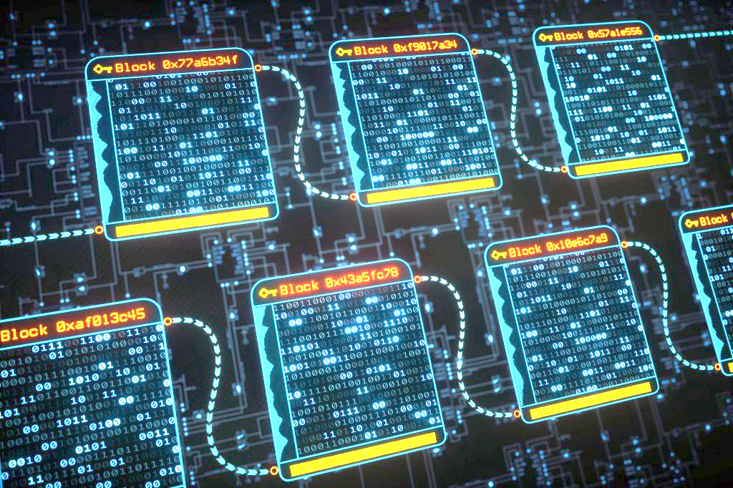
Literature Survey
Data retrieval from stego-object via LSB image steganography is straightforward and data can be easily manipulated or accessed by the attacker. Therefore the data should be encrypted, image should be dynamically chosen to avoid less padding with high throughput and field for error detection.
The emergence of creating a hybrid model similar to blockchain which supports the feasibility to check data integrity without affecting the speed by using the traditional database approach. The main disadvantage of using blockchain technology is that as the size of the data increases the time complexity to verify every transaction also increases.

Slide 9
Proposed Method
Atleast 5 page Add

Slide 10
Algorithm
Atleast 5 page Add

Slide 11
Working

Slide 12
Analysis
Atleast 5 page Add

Slide 13

Future Scope
Optimization of existing AES-512 algorithm by grouping different operations in a round and implementing dynamic programming.
Methods to increase more variation for round keys in key scheduling for AES-512 with an attempt to bring it more closer to AES-128.
Dynamic LSB Steganography implementation with an additional space for error bits to successfully detect manipulation of the data with higher accuracy.
Implementation of data schemas at server with additional features of blockchain by storing hash values. Comparing better alternatives for this implementation either using No-SQL (Firebase/MongoDB) or Relational SQL (Supabase/MySQL/Sqlite3).

Slide 14

Reference
[1] Yeuan-Kuen Lee, Graeme Bell, Shih-Yu Huang, Ran-Zan Wang, and Shyong-Jian Shyu: “An Advanced Least-Significant-Bit Embedding Scheme for Steganographic Encoding”, 2009.
[2] “Applied Cryptography Protocols, Algorithms, and Source Code in C”, A book by Bruce Schneier.
[3] H. Gilbert and M. Minier, “A collision attack on seven rounds of Rijndael”, Proceedings of the 3rd AES Candidate Conference, (2000) April: 230-241.
[4] B. Schneier, “The GOST Encryption Algorithm”, Dr. Dobb’s Journal, v.20, n. 1, (1995) January: 123-124.
[5] "Data security using 512 bits symmetric key based cryptography in cloud computing system", Bijoy Kumar Mandal, Debnath Bhattacharyya and Xiao-Zhi Gao, (2019)
[6] “Efficient High-Performance FPGA-Redis Hybrid NoSQL Caching System for Blockchain Scalability”, Abdurrashid IbrahimSankaMehdi Hasan Chowdhury Ray C.C.Cheung, 2021.

Slide 15
Reference
[7] “The Design of Rijndael AES – The Advanced Encryption Standard”, a book by Joan Daemen, Vincent Rijmen, November 26, 2001.
[8] “AES 512: 512-bit Advanced Encryption Standard Algorithm Design and Evaluation”, Abidalrahman Moh’d and Yaser Jararweh Lo’ai Tawalbeh.
[9] “Ease of Side-Channel Attack on AES-192/256 by Targeting Extreme Keys”, Antonie Wurcker.
[10] “Side Channel Power Analysis of an AES-256 Bootloader”, Colin O’Flynn and Zhizing (David) Chen.
[11] "A Cost analysis of AES-128 and AES-512 on Apple mobile processors", Vatchara Saicheur and Krerk Piromsopa

Slide 16

Akash Kumar Sen
GCECTB-R19-3002
Arijit Mukherjee
GCECTB-R19-3007
Sandeep Shaw
GCECTB-R19-3022
Surajit Bera
GCECTB-R19-3036
THANK YOU

Slide 17
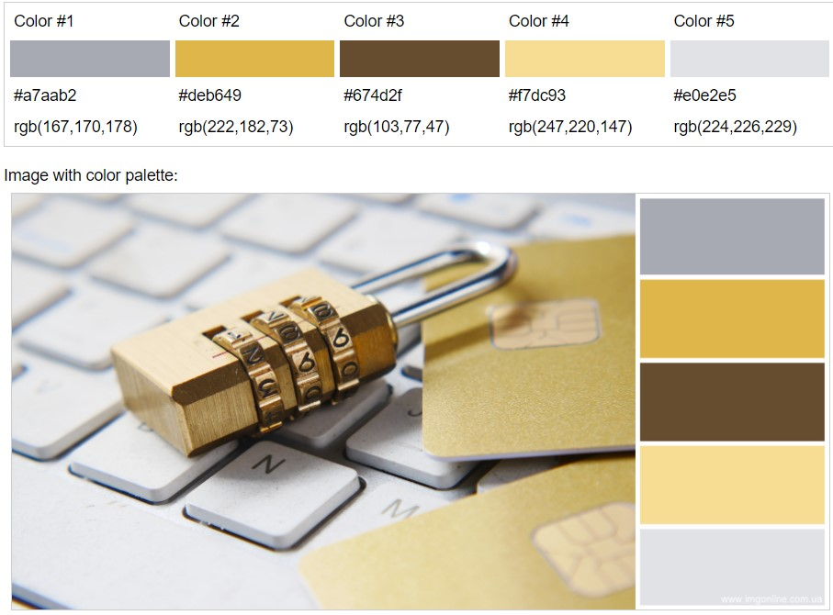
Fonts:
Verdana

